Slide 1

Team 12

Slide 2
Theoretical Architecture
LSTM
Long Term Close Price
10 Years of Stock Data
NLP
RF
Continuous Daily Close Price

Slide 3
Natural Language Processing (NLP)
The NLP component of the Siamese inspired net take gets 5 articles per company analyzed per day of trading
The algorithm then analyzes sentiment for each article and normalizes this data
The training set for the sentiment analysis is 1500 articles and how it impacts stock price for the day of 10 different companies.
The sentiment analysis is then fed into the next two components of the neural network.

Slide 4
Random Forest (RF)
The RF algorithm is used for short term trading.
It can be implemented for minute by minute trading
Given the opening price it can reliably predict the closing price. Because of this RF is very useful for rebalancing the LSTM part of the neural net.
Once the closing price this can be fed into LSTM so that it can adjust its predictions for the long term investing strategy.

Slide 5
Long Short Term Memory (LSTM)
The LSTM is used for long term prediction.
It takes input from the Random Forest algorithm and the NLP sentiment analysis algorithm along with the original data set.
This neural net keeps track of historical trends as well as short term trends to make a viable long term prediction model.
The NLP and RF algorithms are used to improve the short term accuracy of the model to handle things like negative press and general market trends

Slide 6
Business Thesis
The algorithm can be used for BOTH short term and longer term trading
Because the RF returns daily closing estimates accurately it can be used for day trading
LSTM can be used for longer term trading due to its more accurate prediction scheme.

Slide 7
Data Visualization

Slide 8
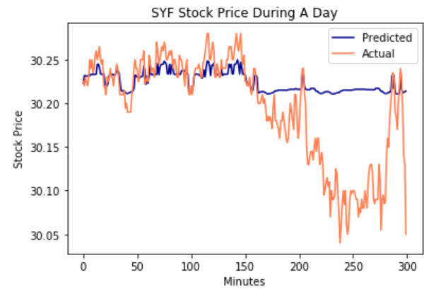
Data Visualization RF - SYF

Slide 9
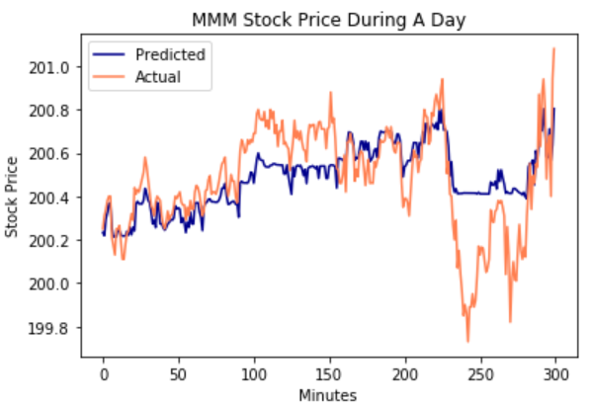
Data Visualization RF - MMM

Slide 10
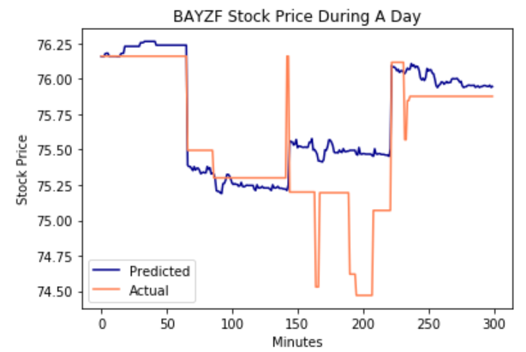
Data Visualization RF - BAYZF

Slide 11
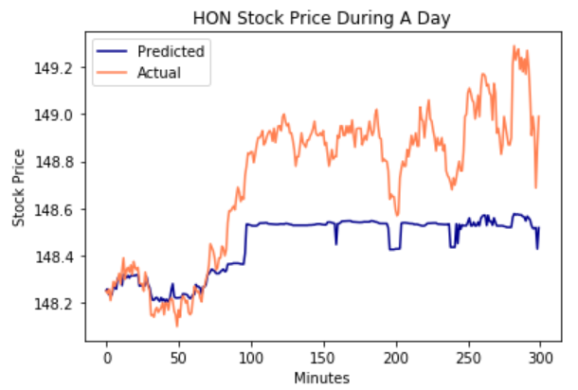
Data Visualization RF - HON

Slide 12
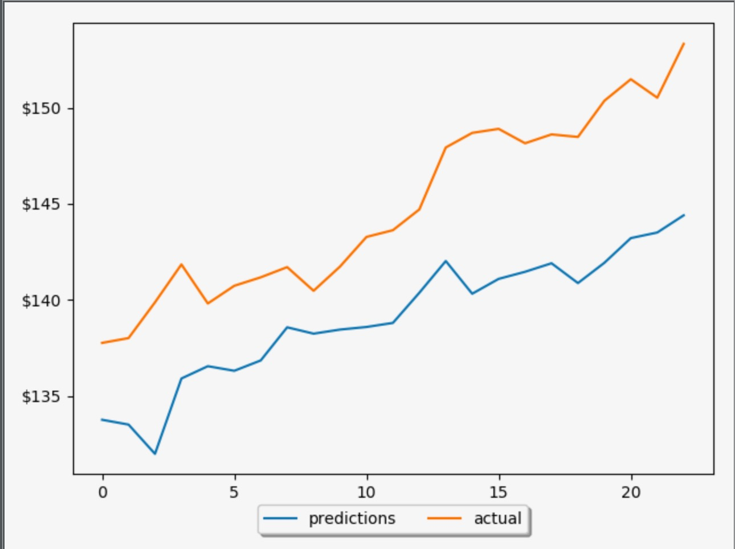
Data Visualization LSTM - HON
Prediction 10 days in advance

